Slide 1




NEXT GEN EMPLOYABILITY PROGRAM
Creating a future-ready workforce
Team Members
College Name
Student Name :L.Ganesh
Student ID :511321205302
Kingston Engineering College

Slide 2

CAPSTONE PROJECT SHOWCASE
Project Title
Building Bus Reservation System using Python and Django
Abstract | Problem Statement | Project Overview | Proposed Solution | Technology Used | Modelling & Results | Conclusion

Slide 3
Abstract
Develop a web application for bus ticket reservation, allowing users to search for buses, select seats, and make reservations.
Frontend (HTML, CSS, JavaScript):
Use HTML to create the structure of your web pages, including forms for inputting reservation details.
Use CSS for styling to make your pages visually appealing and user-friendly.
Use JavaScript to add interactivity, such as form validation and dynamic content loading.
Backend (Python Django):
Use Django models to define your data schema, such as for buses, routes, and reservations.
Use Django views to handle incoming requests from the frontend and interact with the database.
Use Django templates to render dynamic content based on data retrieved from the backend.
By keeping the frontend and backend separate, you can focus on developing each part independently and then integrate them together to create a functional bus reservation system.
Source :

Slide 4
Problem Statement
Develop a web-based bus reservation system to facilitate online booking, seat selection, and reservation confirmation for bus travelers.
Frontend: HTML, CSS, JavaScript
Homepage: Display system overview and search form.
Bus Search Results: Show available buses based on search criteria.
Seat Selection: Allow users to select seats and view total fare.
User Authentication: Implement registration, login, and reservation for authenticated users.
Reservation Confirmation: Display reservation details and allow confirmation.
Payment Integration (Optional): Integrate a payment gateway for online transactions.
Source :

Slide 5
Project Overview
Develop a user-friendly web application for booking bus tickets online, using HTML, CSS, JavaScript for the frontend and Python Django for the backend.
User Registration and Authentication: Allow users to register, log in, and manage their accounts securely.
Bus Search and Selection: Provide a search functionality for users to find buses based on their travel details.
Seat Selection: Enable users to select seats from an interactive seat map.
Reservation Management: Allow users to view and manage their reservations, including canceling bookings.
Admin Panel: Provide an admin interface to manage buses, seats, and reservations, with features such as adding/editing buses and managing seat availability.
Source :

Slide 6
Proposed Solution
.
INTRODUCTION
Brief overview of the bus reservation system project.
Goals and objectives of the project.
Technologies used: Frontend (HTML, CSS, JavaScript), Backend (Python, Django)
System Overview
Description of the system's main features.
User roles: Customers, Admin.
Frontend Development
Description of the frontend technologies used (HTML, CSS, JavaScript).
Overview of the frontend architecture and design principles.
Source :

Slide 7
Backend Development
Description of the backend technologies used (Python, Django).
Overview of the backend architecture, including database design and API development.
Homepage
Description of the homepage layout and functionality.
Overview of the search form and its features.
Bus Search Results
Description of how bus search results are displayed.
Explanation of how buses are filtered based on user input.
Source :

Slide 8
Seat Selection
Description of the seat selection process.
Overview of the seat layout and selection mechanism.
User Authentication
Description of the user registration and login process.
Explanation of how authentication is implemented.
Reservation Confirmation
Description of the reservation confirmation process.
Overview of the reservation details displayed to the user.
Source :

Slide 9


Technology Used
Front-end
Back-end
Source :

Slide 10
Modelling & Results
Bus Model
Attributes: bus_number, departure_time, arrival_time, price.
Methods: get_available_seats().
Seat Model
Attributes: seat_number, is_available.
Methods: book_seat(), cancel_booking().
User Model
Attributes: username, email, password.
Methods: authenticate(), create_reservation().
Source :

Slide 11
Homepage
The homepage of the bus reservation system is the user's first point of contact, providing a brief overview and guiding them to key actions.
Header Section: Includes the system's name/logo and navigation links.
Hero Section: Features an image related to bus travel and a call-to-action button for searching buses.
Search Form: Prominent form for entering travel details.
Featured Routes/Offers: Highlights popular routes or offers.
How It Works Section: Briefly explains the reservation process.
Testimonials/Reviews: Builds trust with customer feedback.
Footer Section: Contains contact information and legal details.
Responsive Design: Ensures compatibility with all devices.
User-Friendly Layout: Intuitive navigation and clear call-to-action buttons.
Visual Appeal: High-quality images and engaging colors.
Responsive Design: Ensures compatibility with all devices.
User-Friendly Layout: Intuitive navigation and clear call-to-action buttons.
Visual Appeal: High-quality images and engaging colors.

Slide 12
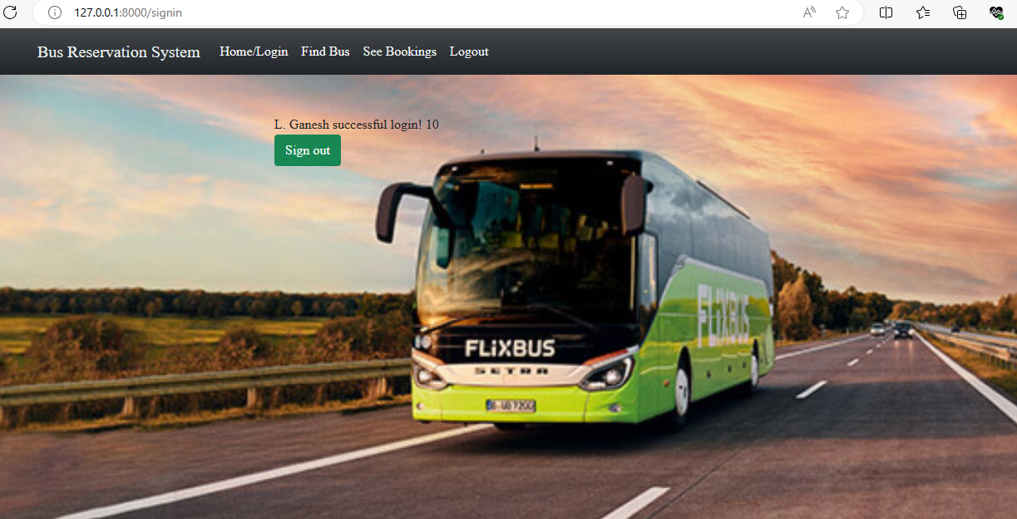
About-Us-Page

Slide 13
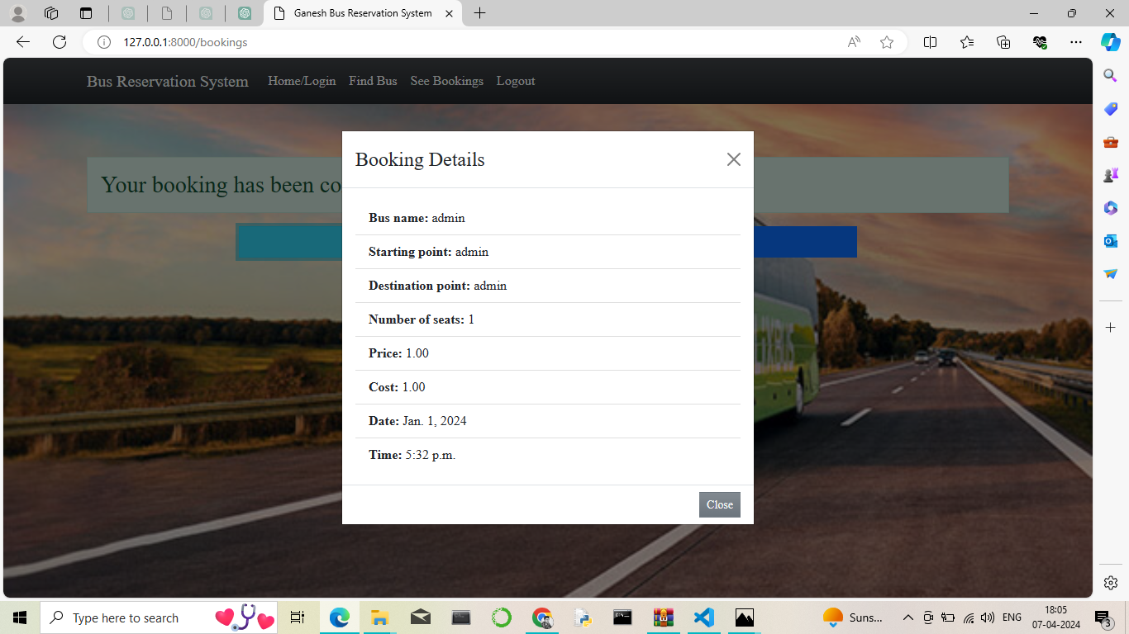
Service-Page

Slide 14
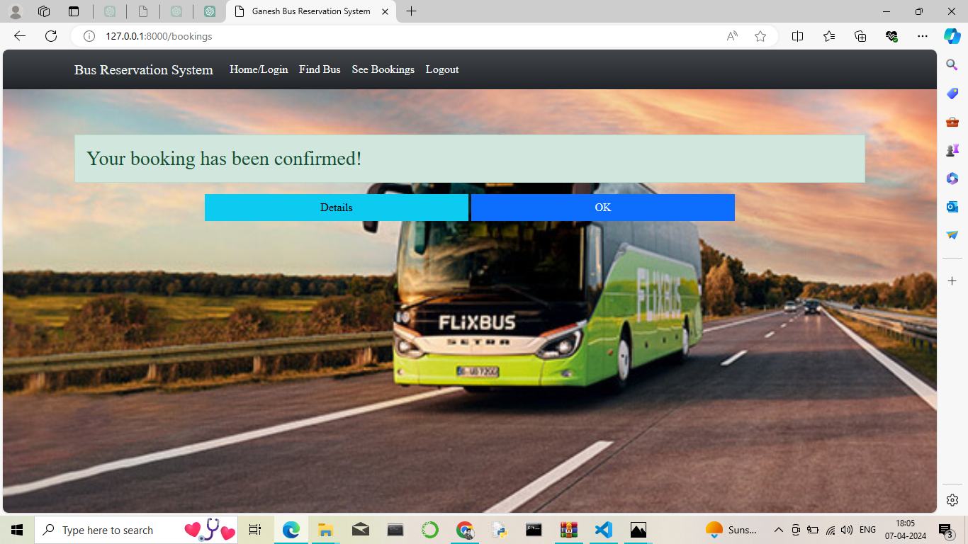
Departments-Page

Slide 15
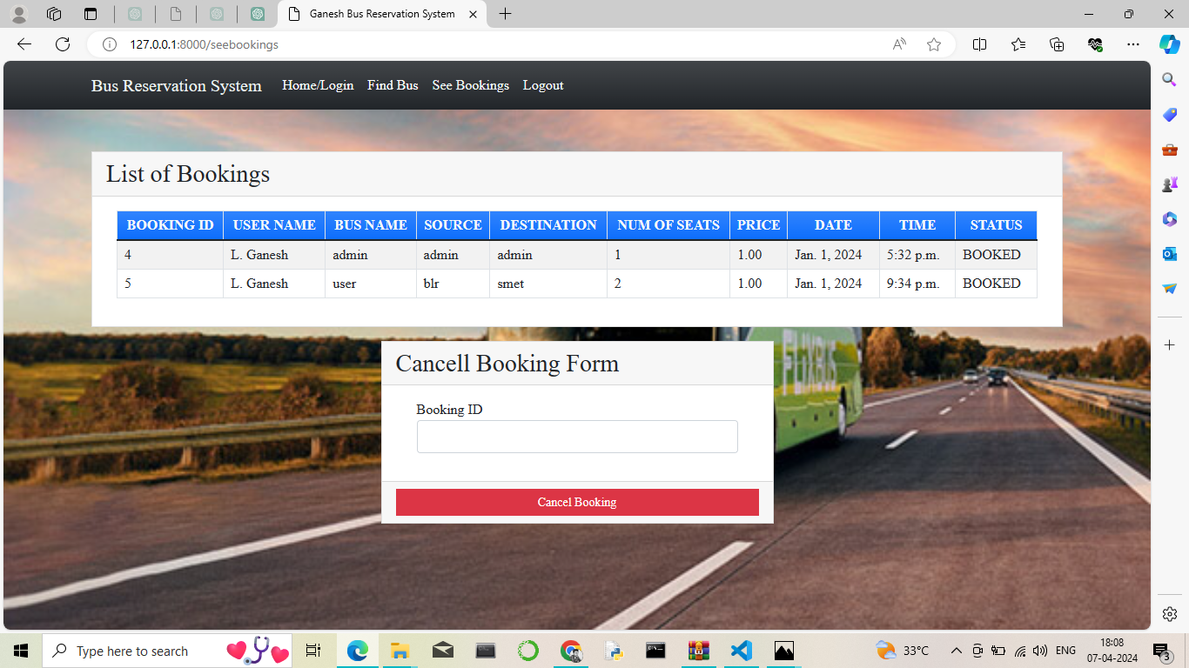
Blog-Page

Slide 16
Future Enhancements:
User Experience Improvements:
Implementing a more intuitive and responsive design for the frontend to enhance user experience.
Adding features such as auto complete for search fields, interactive seat selection, and real-time updates on bus availability.
Payment Gateway Integration:
Integrating a payment gateway to allow users to make reservations online securely.
Notification System:
‘
Adding a notification system to send booking confirmations, reminders, and updates to users via email or SMS.

Slide 17
Conclusion
In conclusion, the development of a bus ticket reservation application using HTML, CSS, Python, Django, and MySQLite3 presents a robust and versatile solution for managing bus bookings effectively. Through the integration of these technologies, the application can offer a user-friendly interface, seamless booking process, and efficient data management.
HTML and CSS provide the foundation for creating a visually appealing and responsive user interface, ensuring that passengers can easily navigate the application across different devices. JavaScript enhances the interactivity of the application, enabling dynamic features such as form validation and interactive elements.
Overall, the integration of HTML, CSS, Python, Django, JavaScript, and MySQLite3 empowers the bus ticket reservation application to provide a streamlined and efficient booking experience for passengers while offering administrators the tools they need to manage operations effectively. With continuous updates and enhancements, the application can remain competitive and meet the evolving needs of the transportation industry.
Source :

Slide 18
Thank You!
Notes:
Thank You !!

